Slide 1
Chapter 6

Slide 2
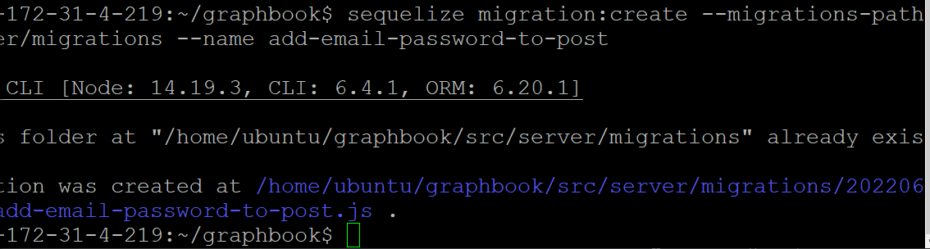

Slide 3
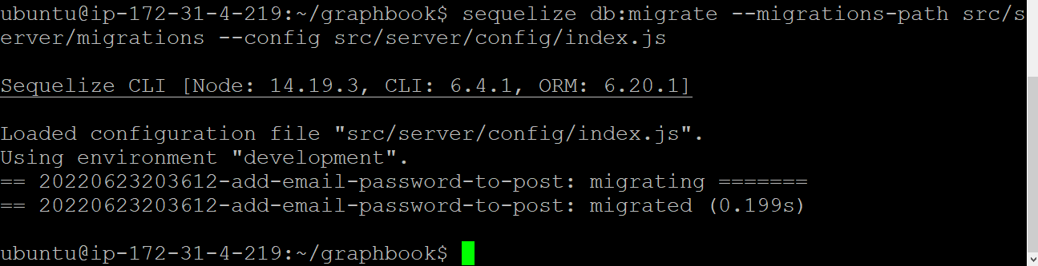

Slide 4
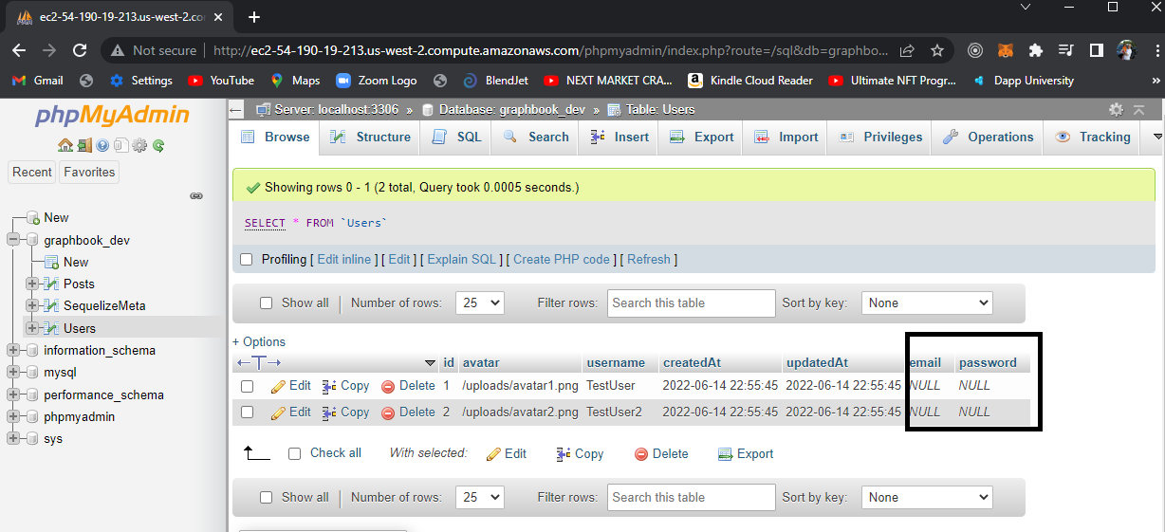

Slide 5
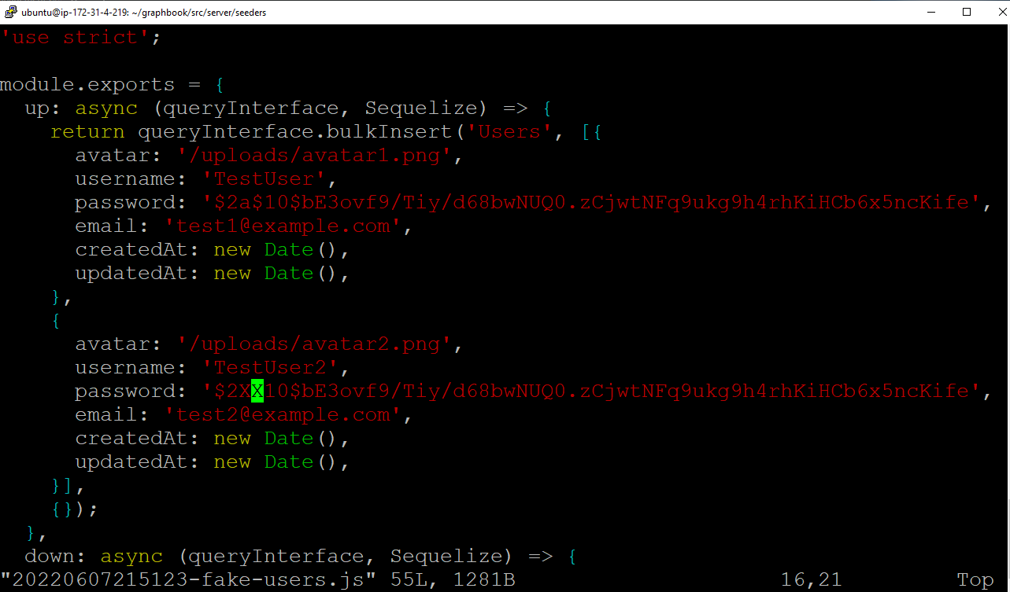

Slide 6
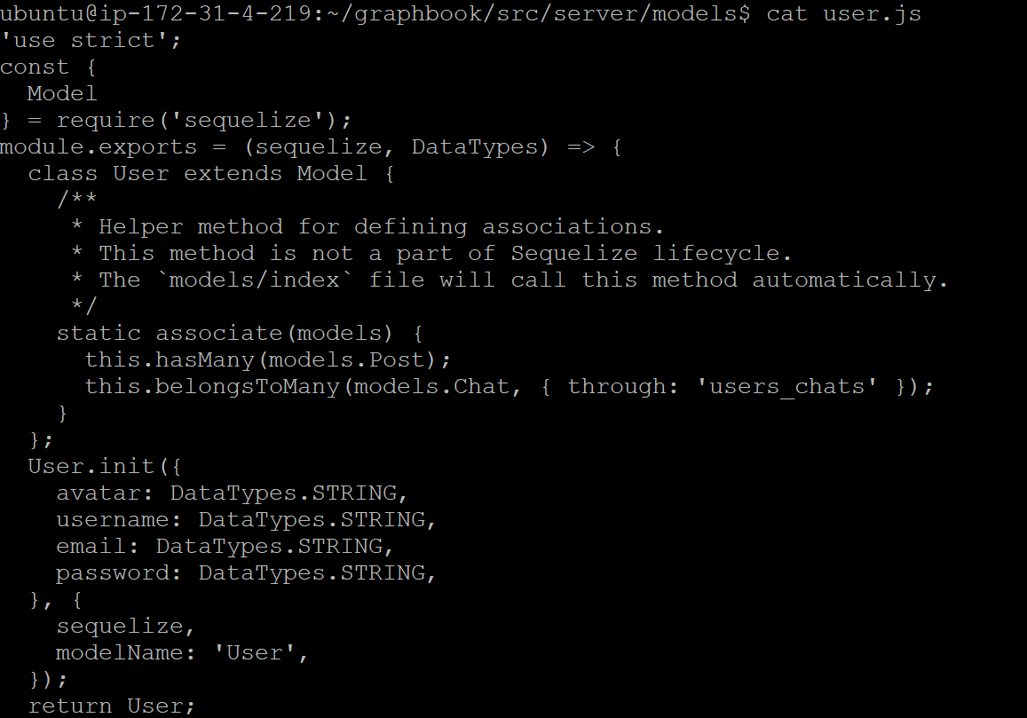

Slide 7
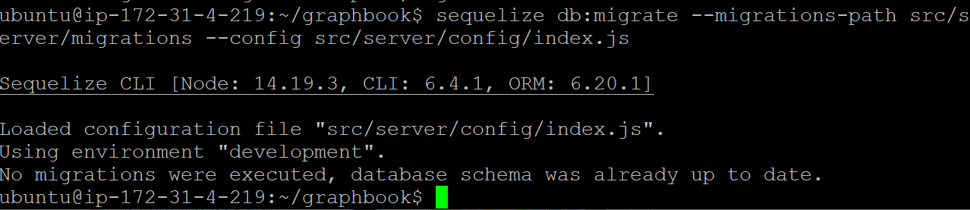

Slide 8
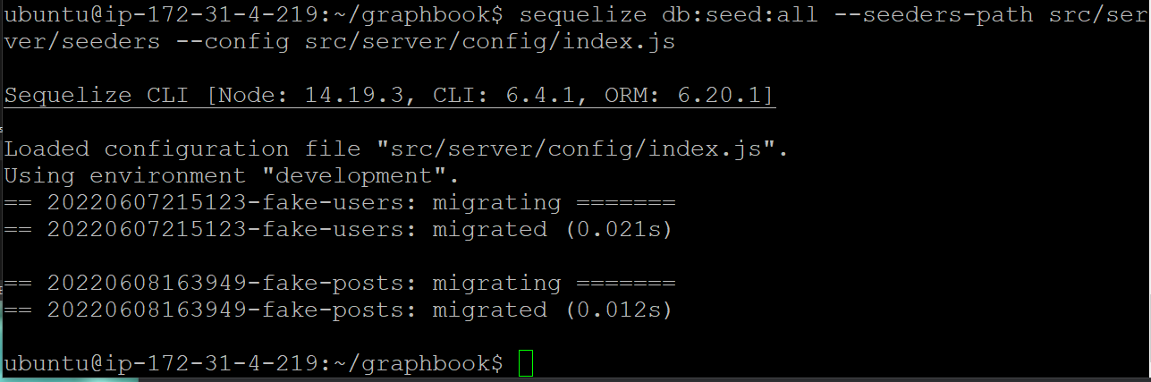

Slide 9
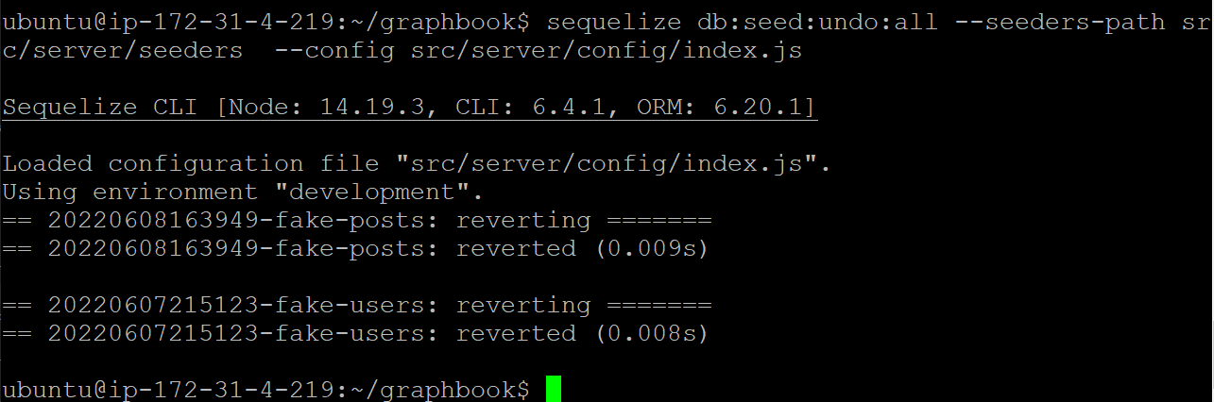
Didn’t work, so I have to do an undo all

Slide 10
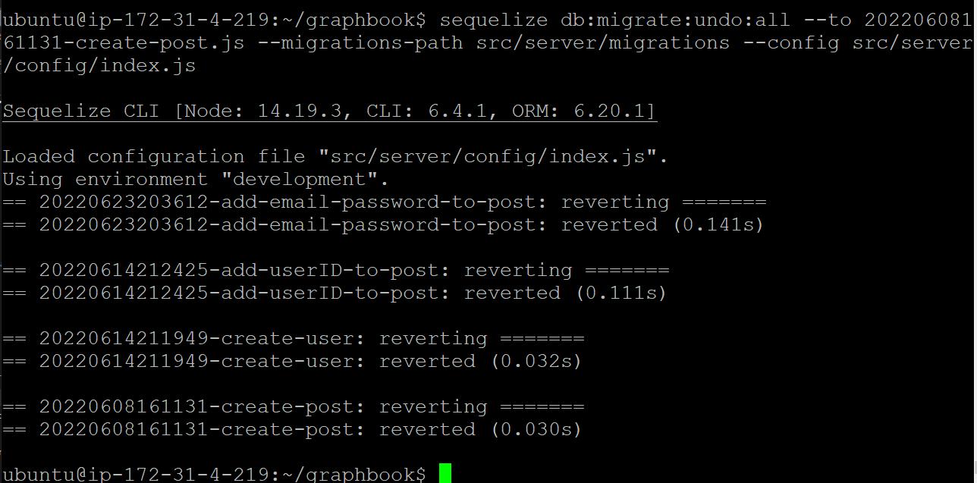

Slide 11
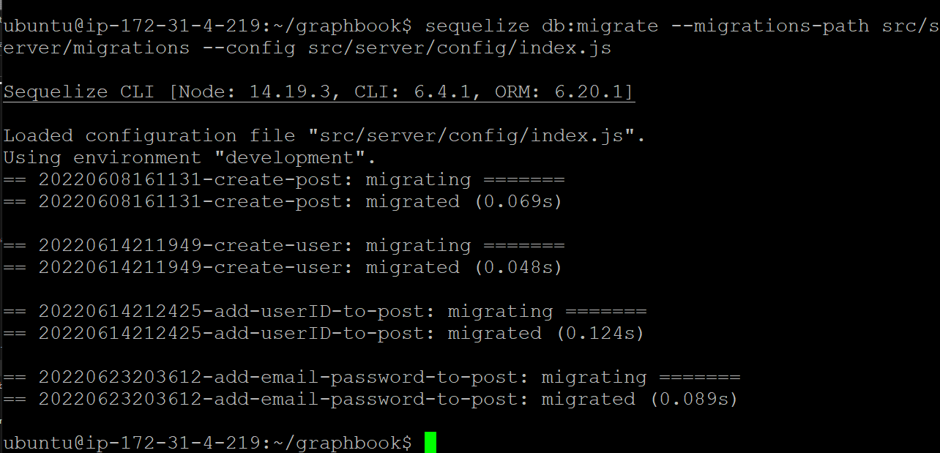

Slide 12
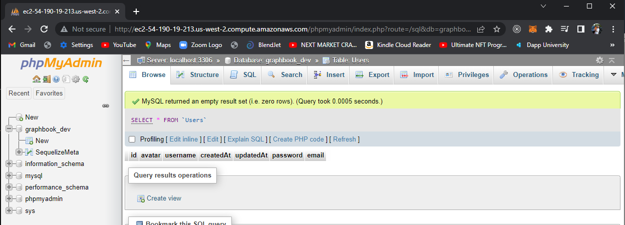

Slide 13
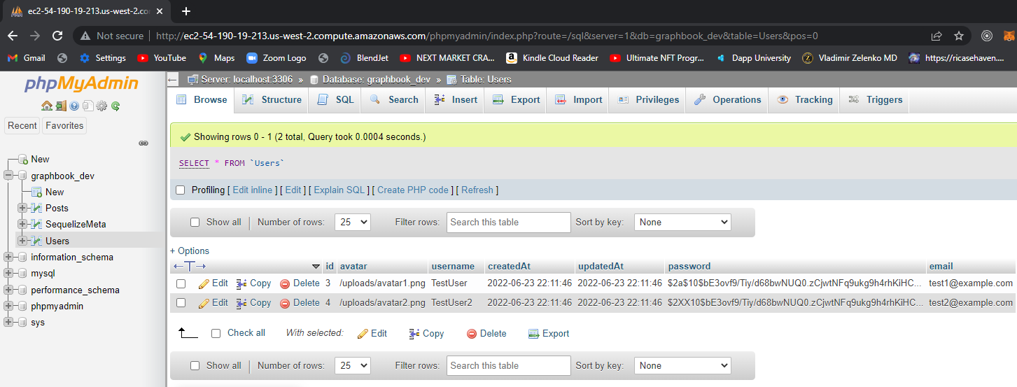

Slide 14
Apollo login mutation
Src/server/mode/user.js
/graphbook/src/server/services/graphql/schema.js
Graphbook/src/server/services/graphql/resolvers.js

Slide 15
Files added to support the login form:
Chapter06/src/client/apollo/mutation/login.js
Src/client/components/loginregister.js
App.js
Src/client/components/error.js
Src/client/components/loading
.env

Slide 16
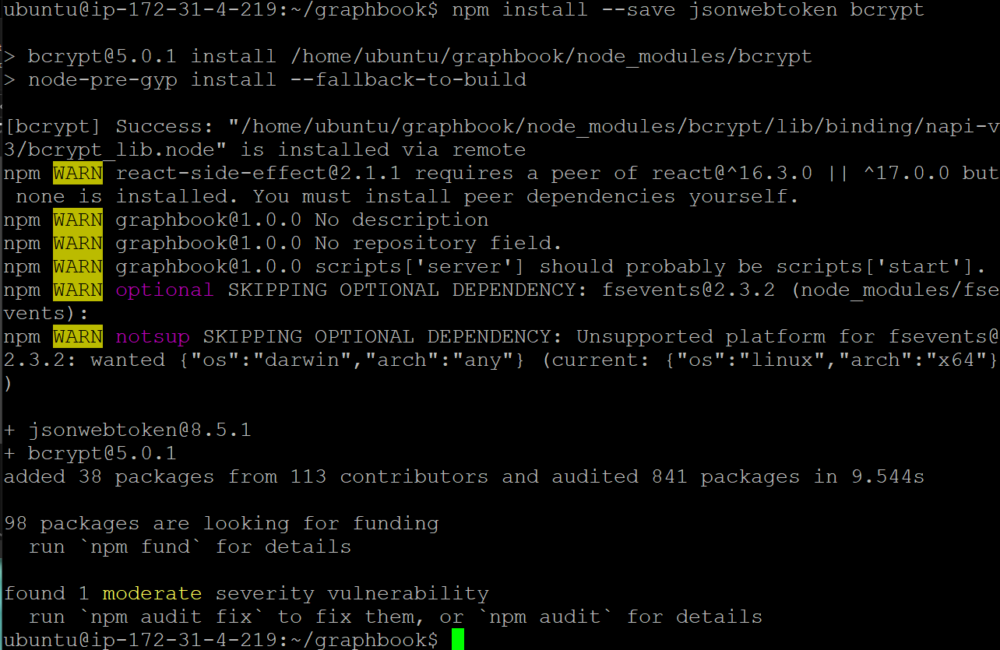

Slide 17
cd src/server/services/graphql
ls
vi schema.js

Slide 18
export JWT_SECRET=Asdadfafasdfasdfsadfsadfsadfasdfasdfasddddddddddddddddd

Slide 19
cd src/server/services/graphql
ls
vi resolvers.js

Slide 20
Error! (see next page)

Slide 21
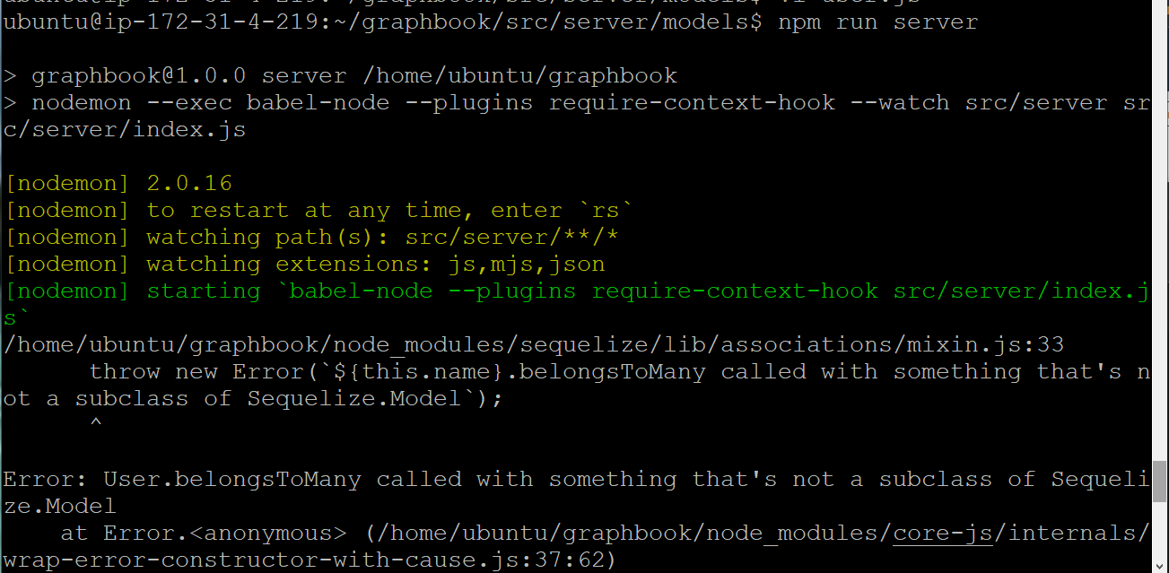

Slide 22
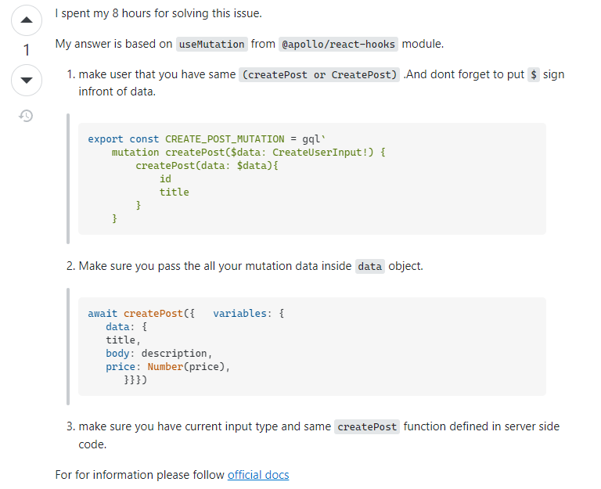
Stuck! See next page!!!!!! Tried below idea to NO avail ( use data block!)

Slide 23
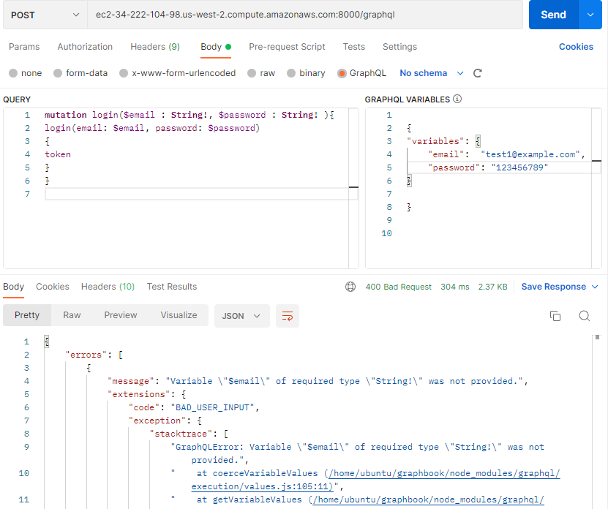

Slide 24
https://stackoverflow.com/questions/59311928/variables-of-required-type-not-provided-despited-their-validity

Slide 25
export JWT_SECRET=Asdadfafasdfasdfsadfsadfsadfasdfasdfasddddddddddddddddddddddddddddsadffffffffffvadfadfasdfasssssssss1231231231231231321231231231

Slide 26
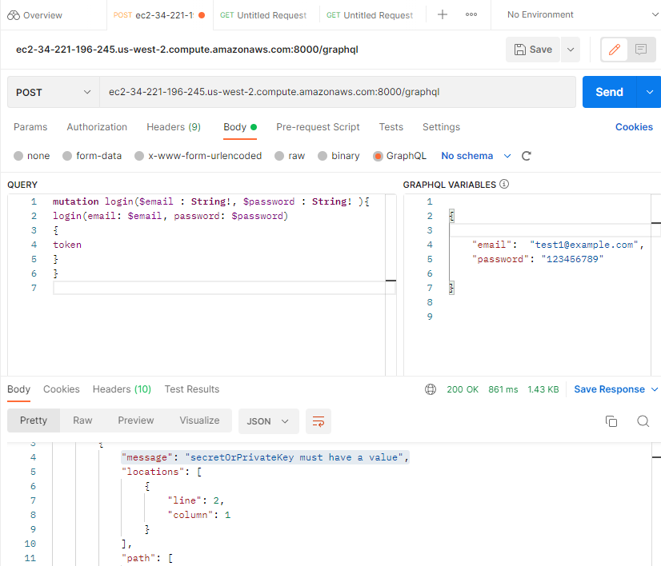

Slide 27
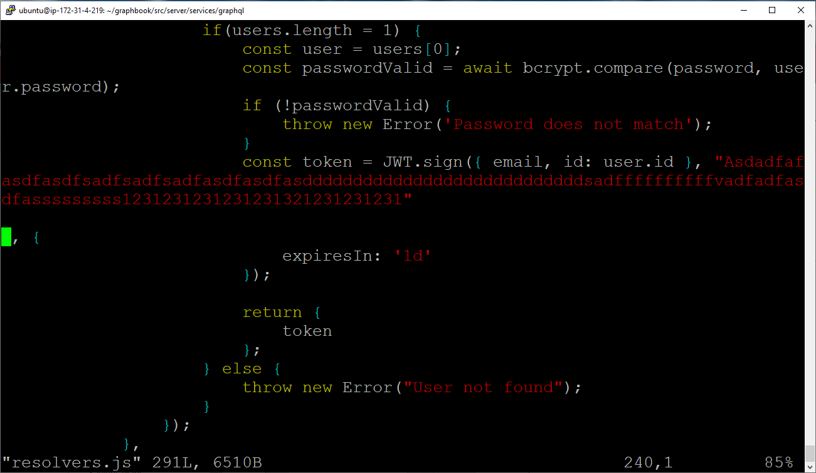
Temporary solution – I needed to hardcode the values in my solution (see below of resolvers.js)

Slide 28
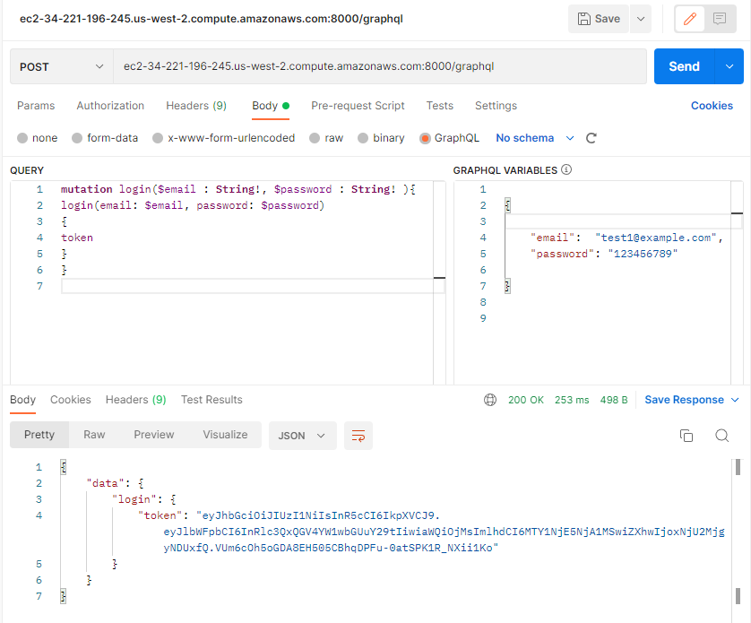

Slide 32
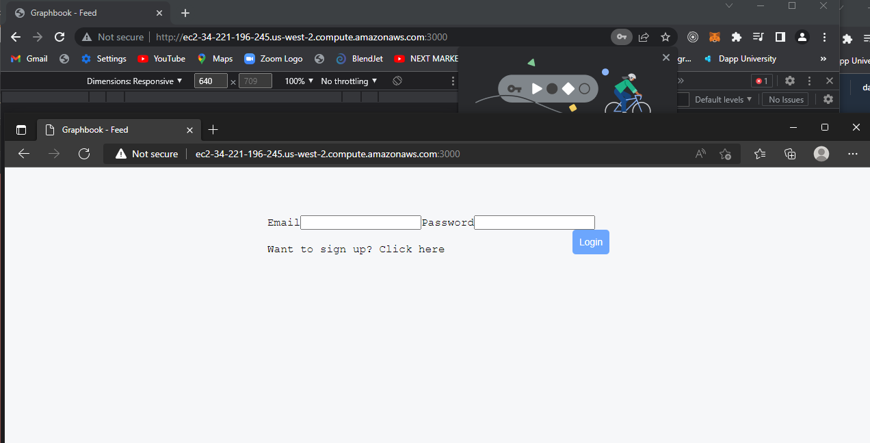

Slide 33
